Slide 1


Welcome
To E-KYC process

Slide 2
Stages of E-KYC Process
Homepage: Verification using Mobile & Email OTP
Address: Proof of address verified through KRA & if KRA is not found, then it moves to the Digilocker journey
Bank: Input UPI ID & approved or input Bank details
Profile: Input personal details
Demat: DP scheme selection
Exchange: NSE/BSE – Cash Segment & BSE Star MF
IPV: Online In-Person Verification
Signature – Click a photo of your signature and upload OR upload a photo of your signature
Digital Sign – 1) KRA application 2) KYC Application

Slide 3
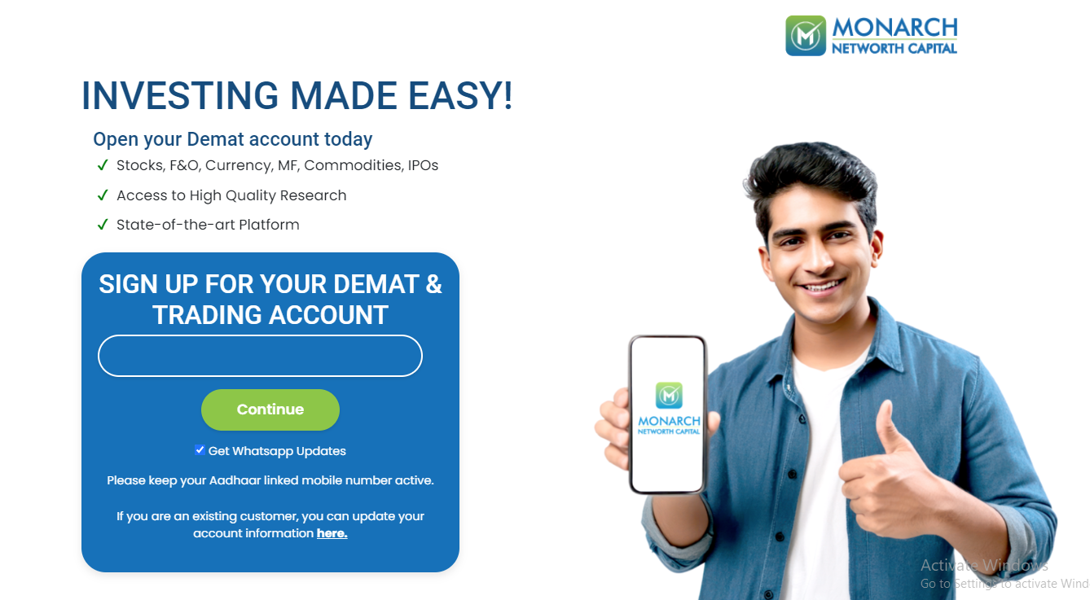
Open Demat & Trading Account
Enter your mobile and click on ‘Get OTP’

Slide 4
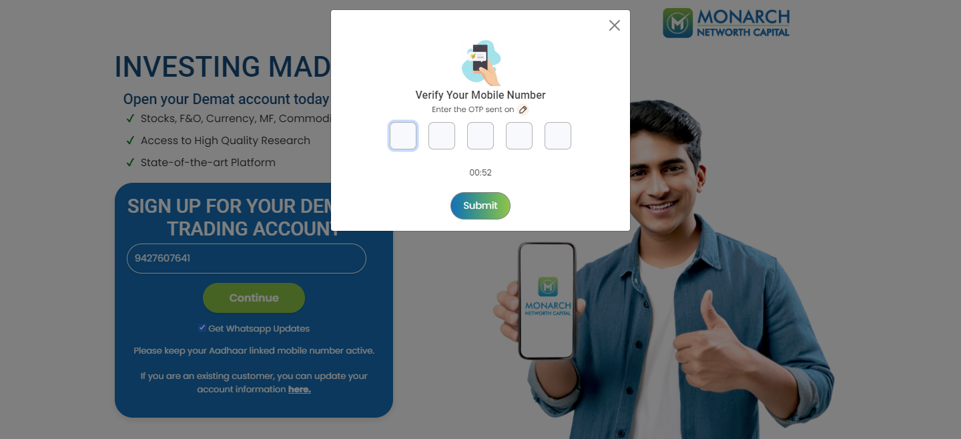
Homepage of EKYC
A OTP will be sent to the given mobile number. Please enter the OTP and click Submit. If you did receive the OTP, please click on Resend OTP

Slide 5
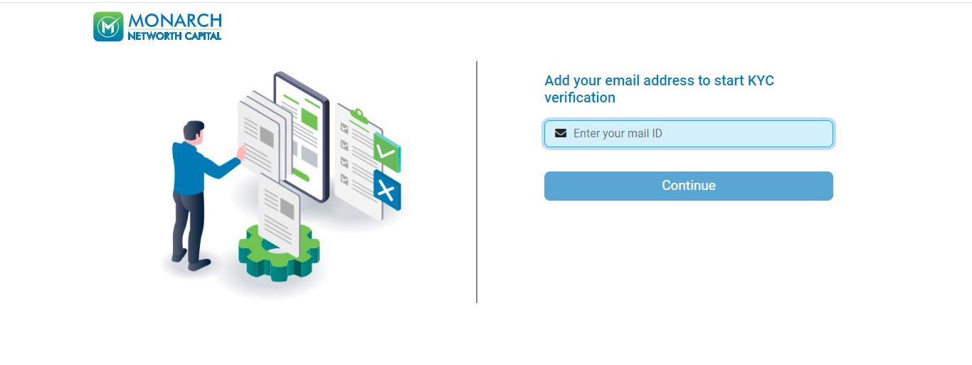
Enter your email ID and click on Continue

Slide 6
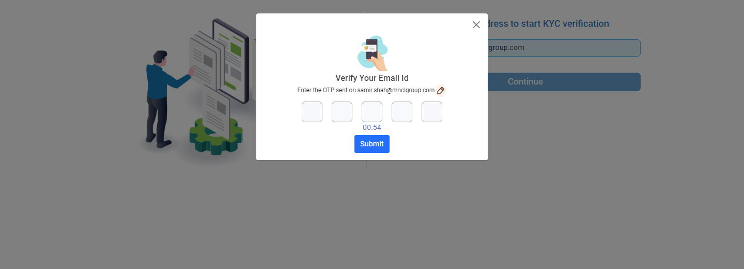
Enter OTP to validate E mail ID

Slide 7
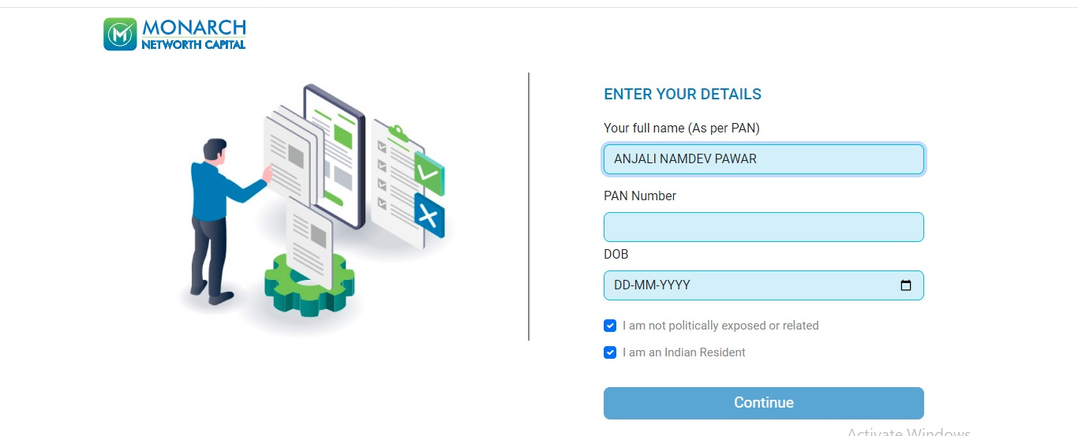

Enter your Full name as per your PAN Card and yourPAN Number details and then click to continue.

Slide 8
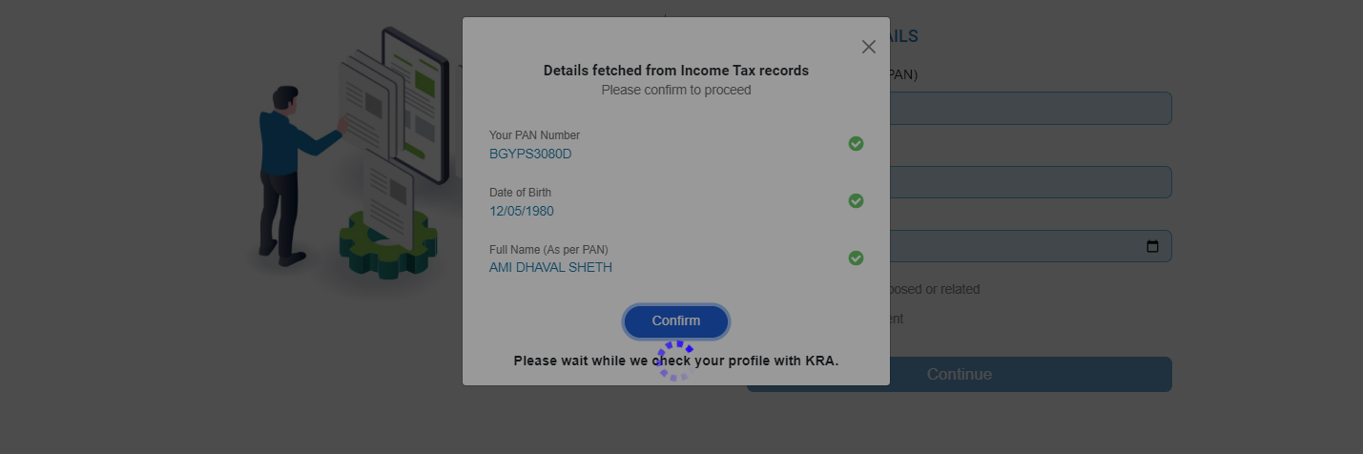

Please confirm details to proceed

Slide 9
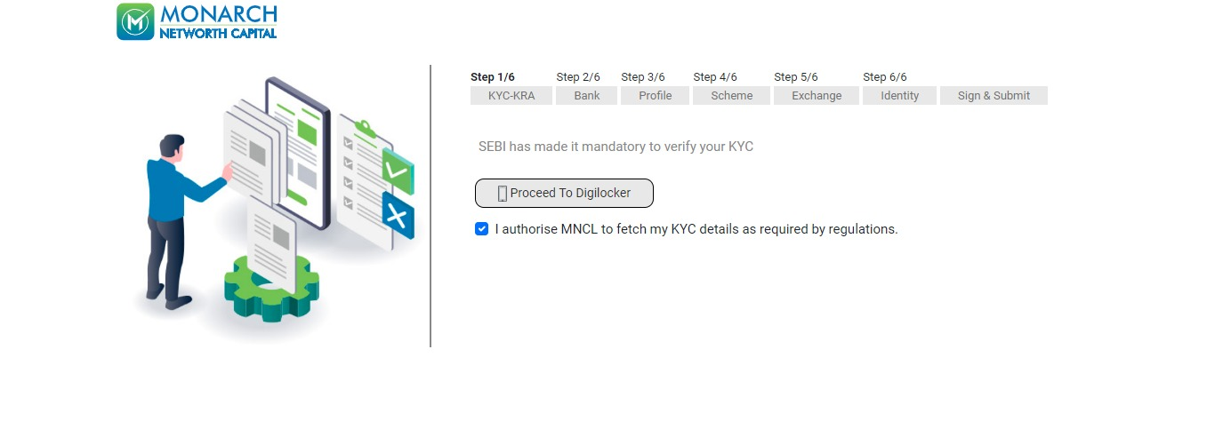
KRA Journey will be auto fetched, if there is an error in KRA journey this page will appear, Click on Proceed to cont. with Digilocker

Slide 10
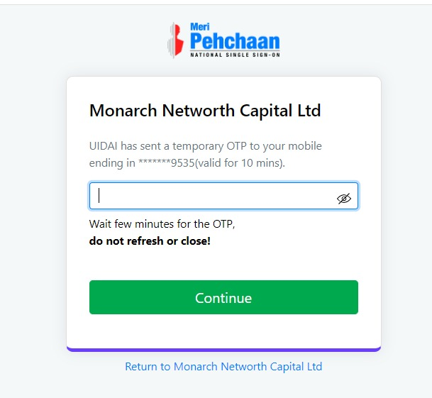
Digilocker Journey:
Enter your mobile no.

Slide 11
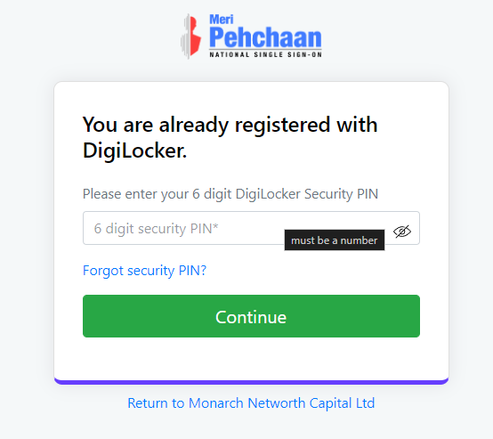
Digilocker Journey:
Enter 6 digit PIN

Slide 12
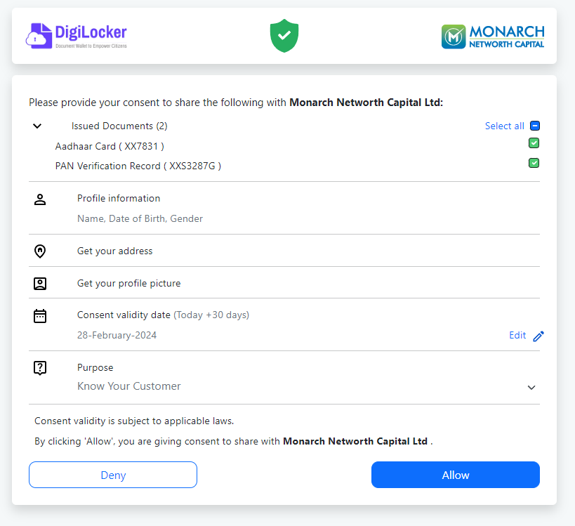
Digilocker Journey:
Allow permission

Slide 13
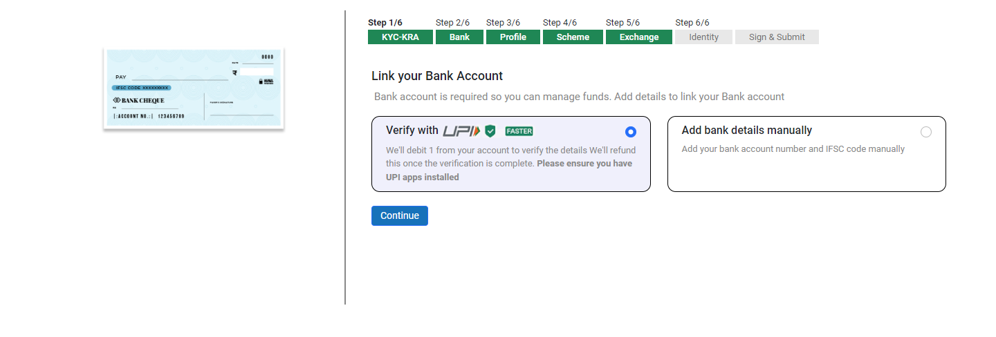
Bank Page:
Link your bank account.
If you have a UPI ID then select “Verify with UPI” or select “Add bank details manually”

Slide 14
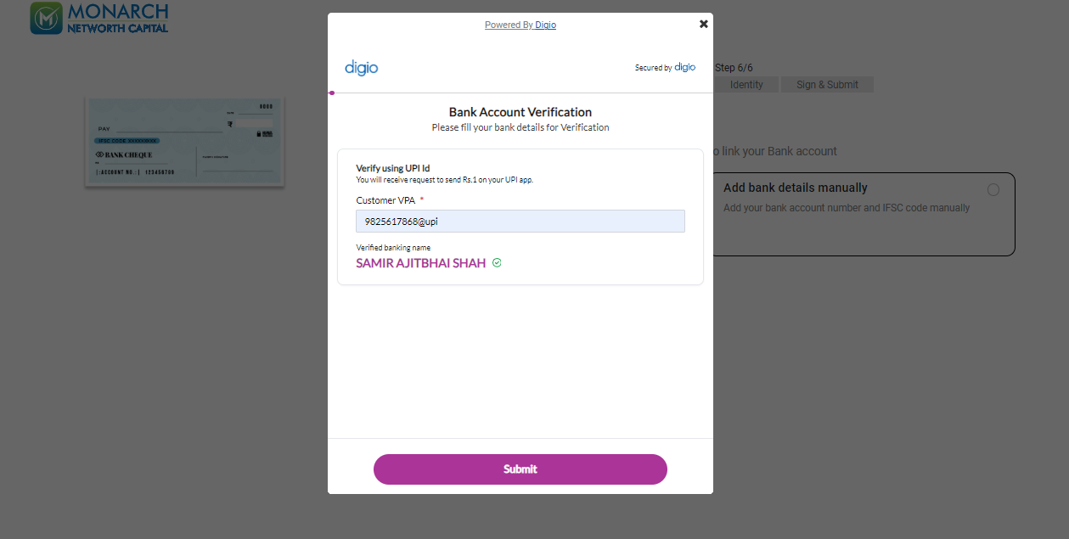


Bank Page:
Verify with UPI

Slide 15
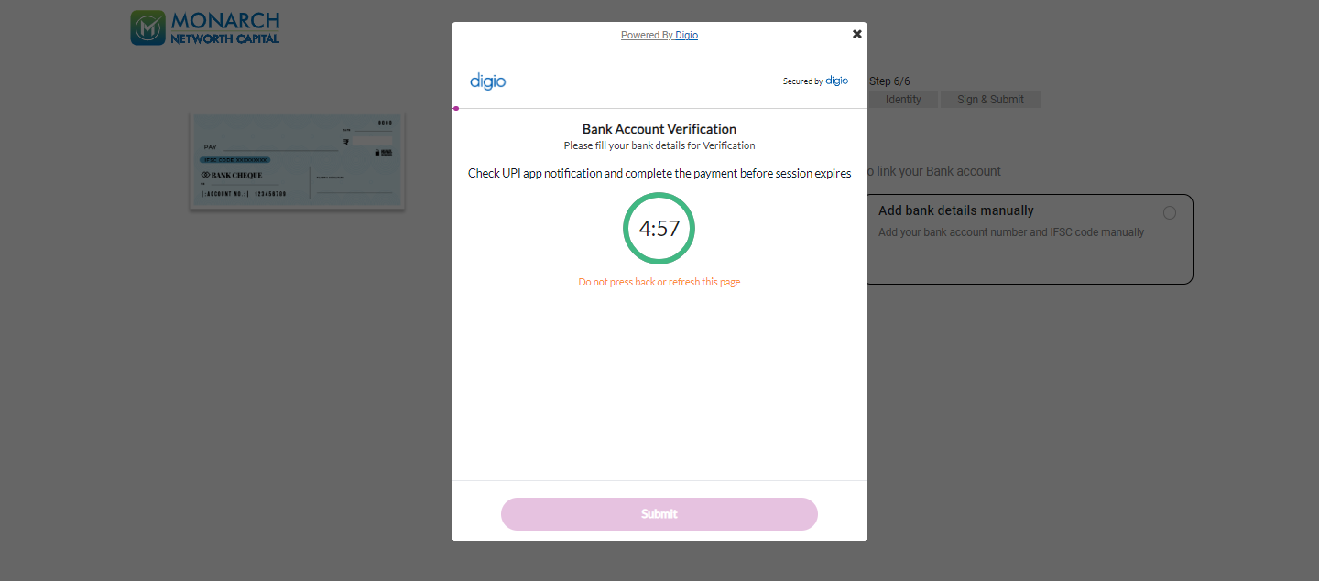
Bank Page:
Bank Account Verification – Check the UPI app notification and approve to complete the payment before the session expires.

Slide 16
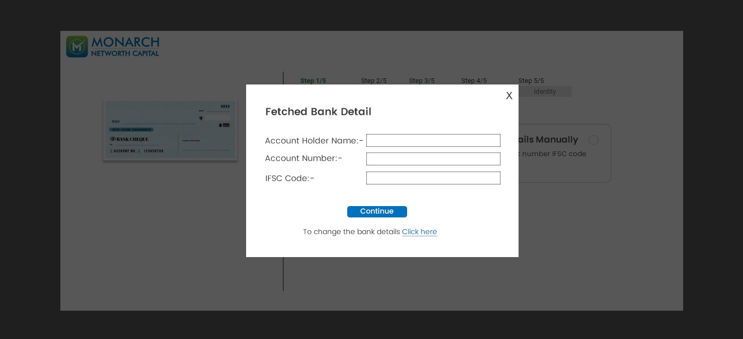

Bank Page:
Confirm the fetched bank details

Slide 17
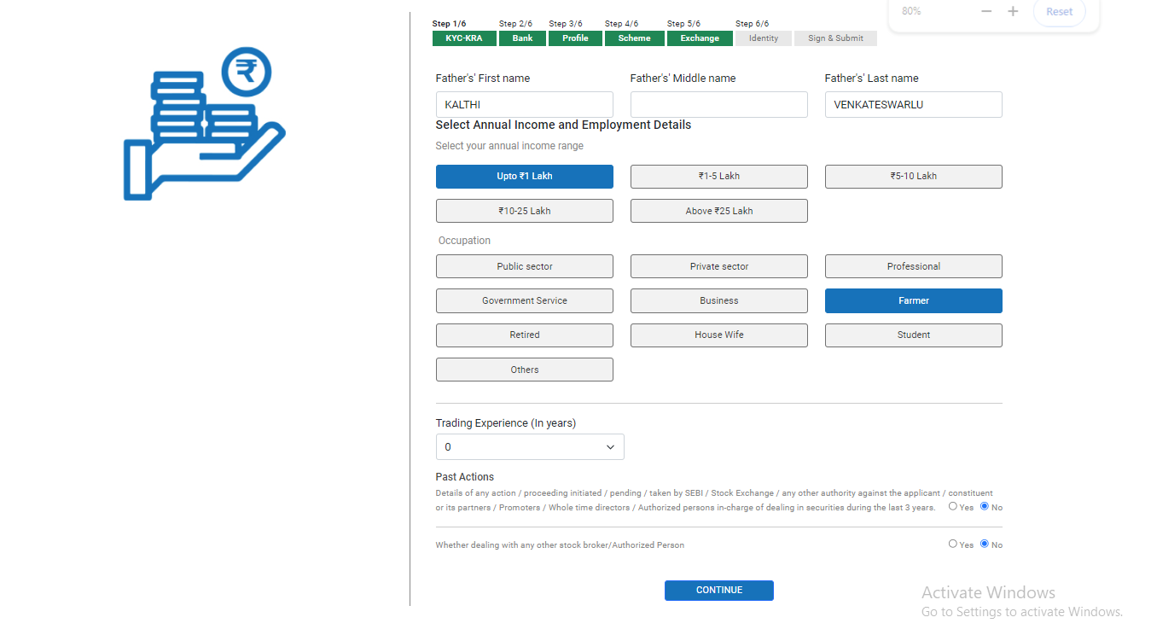
Profile page
Enter personal details

Slide 18
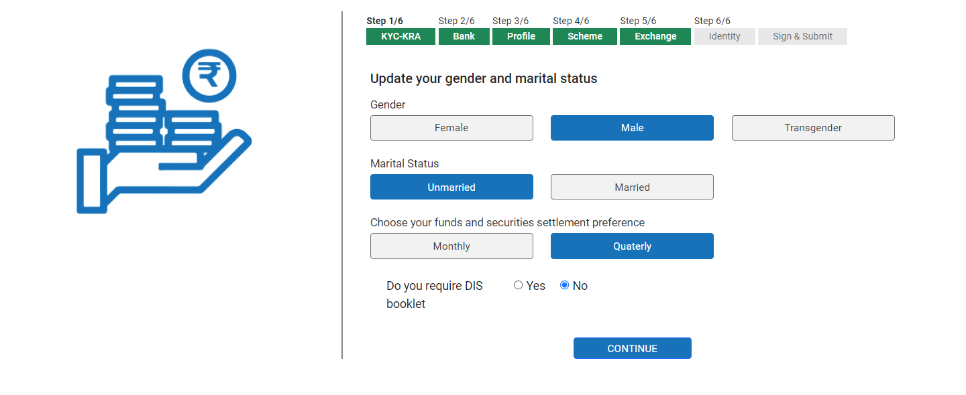
Profile page continued
Select personal details

Slide 19
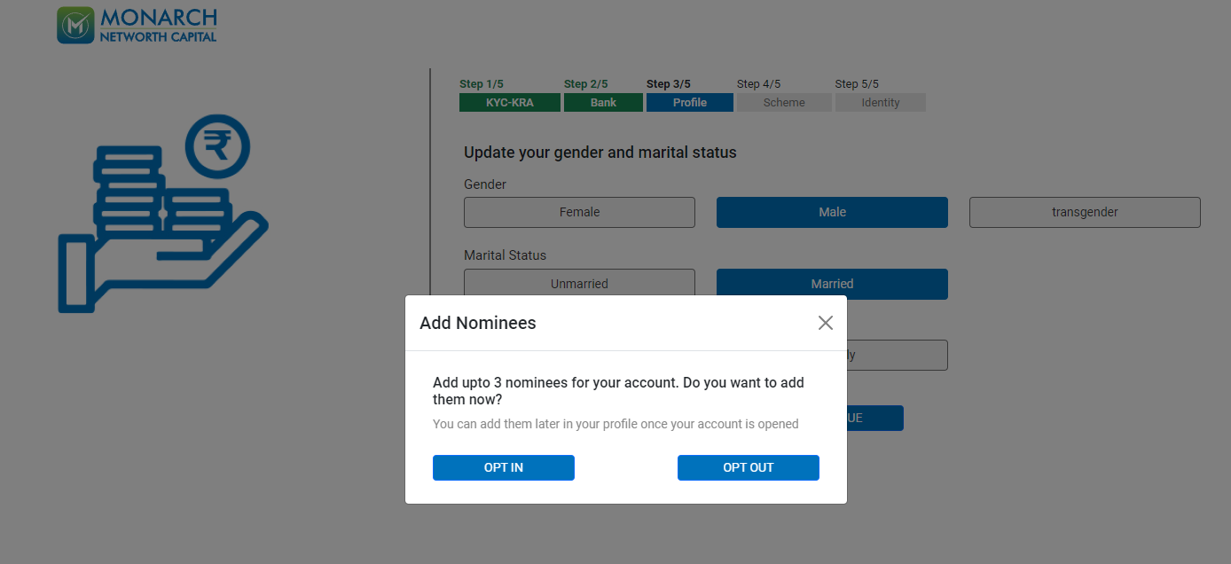
Nominee:
Select Nominee details

Slide 20
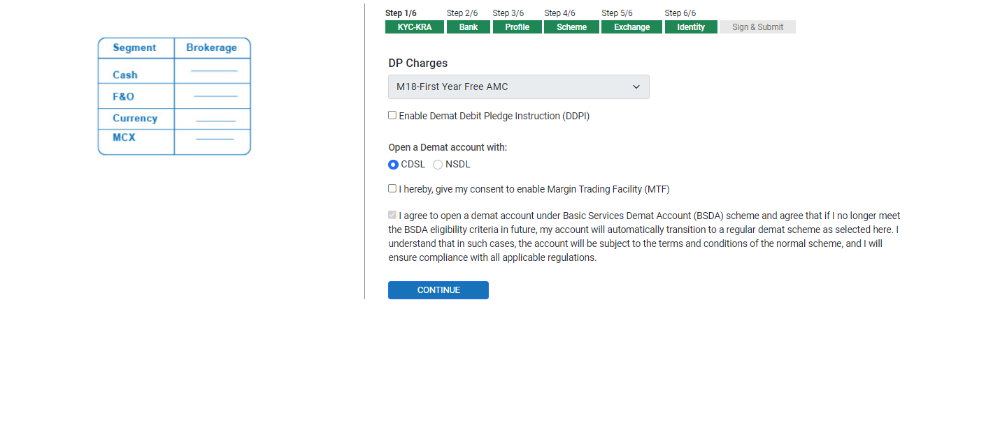
Scheme Page :
DP scheme as applicable

Slide 21
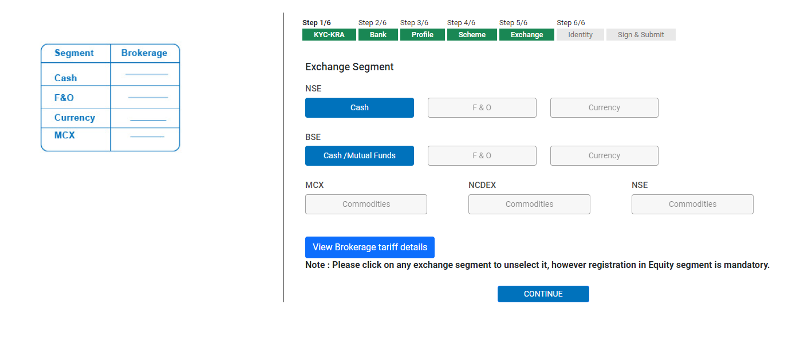
Exchanges as applicable
Exchange Page:

Slide 22
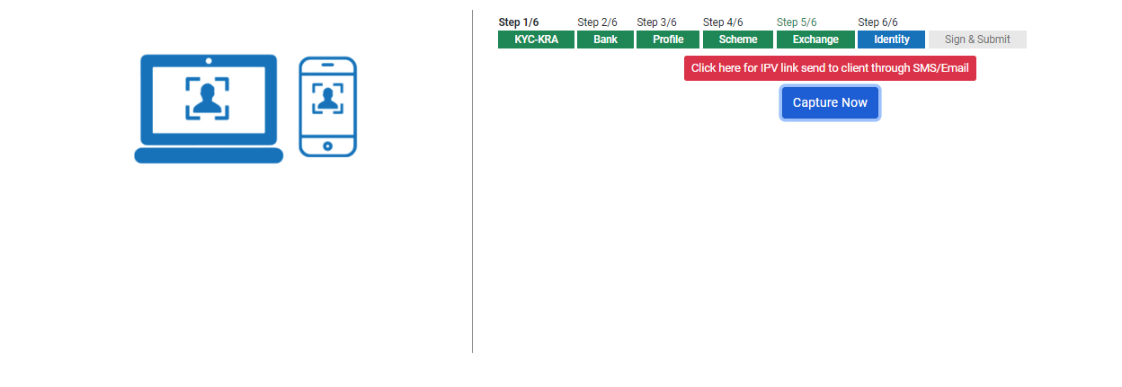
Click on capture now and take a selfie
Capture Image:

Slide 23
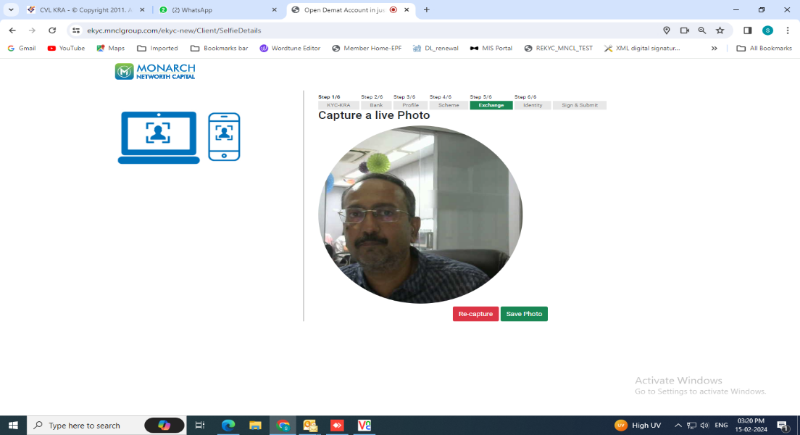
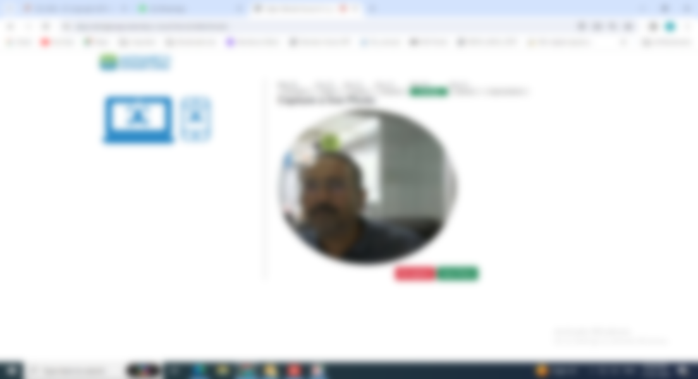
Click on save photo if full face found in a circular
Capture Image:

Slide 24
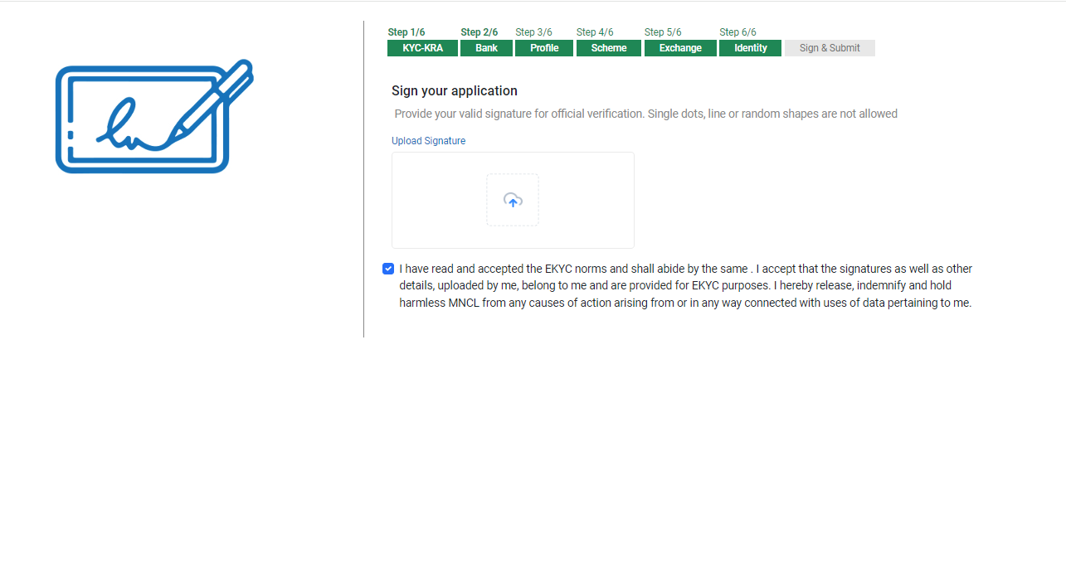
Upload your signature
Sign on Screen:

Slide 25
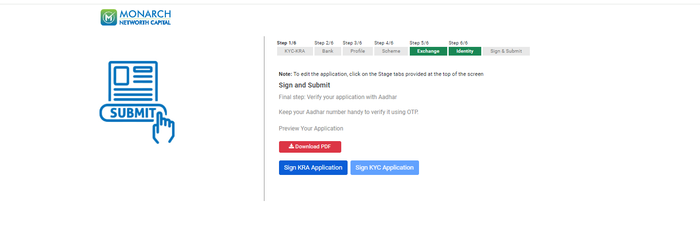
Verify your application (E-sign) with Aadhar – Keep your Aadhar number handy
Account Opening Form pdf:

Slide 26
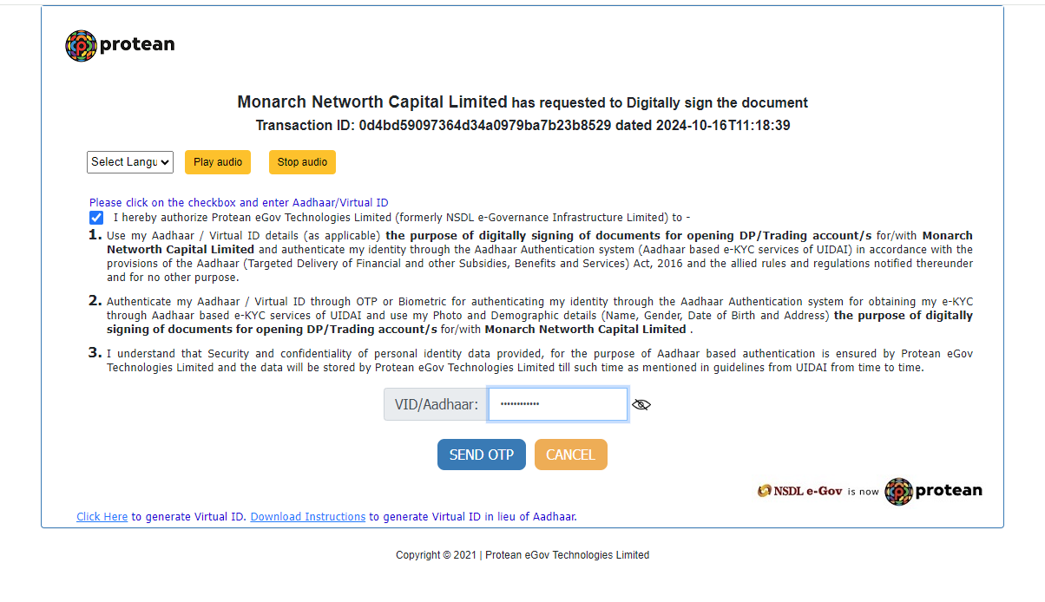
Accept Terms & Conditions, Enter your Aadhar no. and click on send OTP
Sign KRA application :

Slide 27
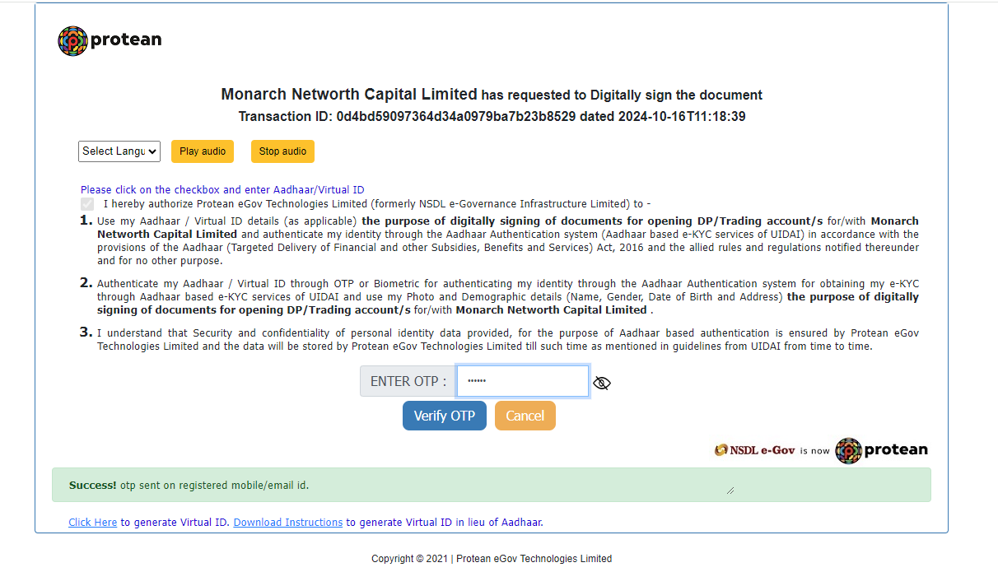
Enter OTP & click on Verify OTP
Sign KRA application :

Slide 28
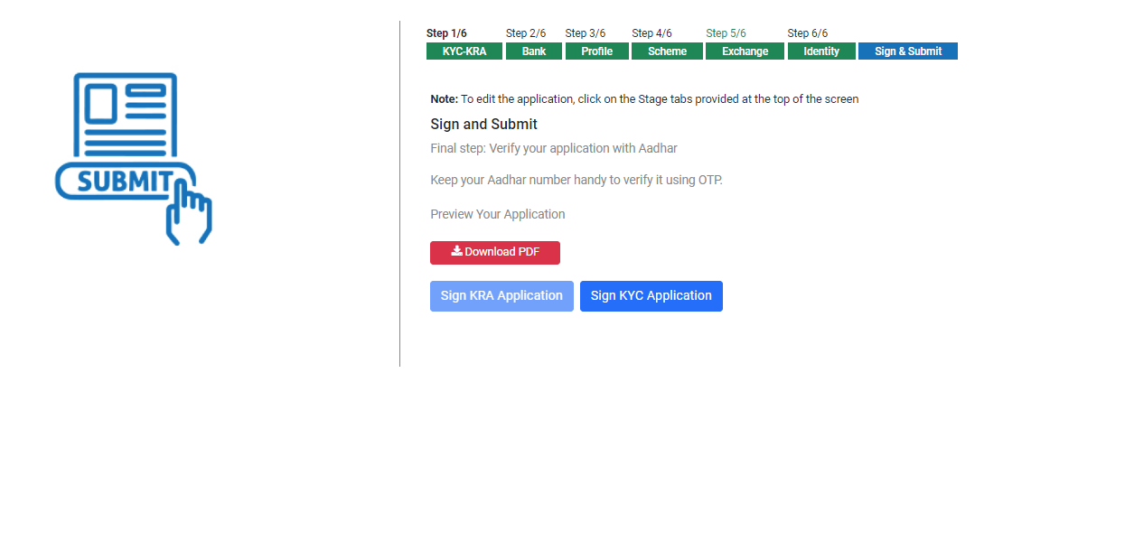
Verify your KYC application with Aadhar
Sign KYC application:

Slide 29
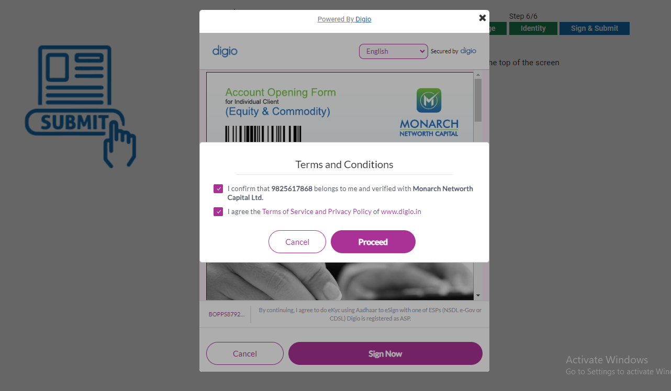
Accept Terms & Conditions and click on Proceed
Sign KRA application OTP :

Slide 30
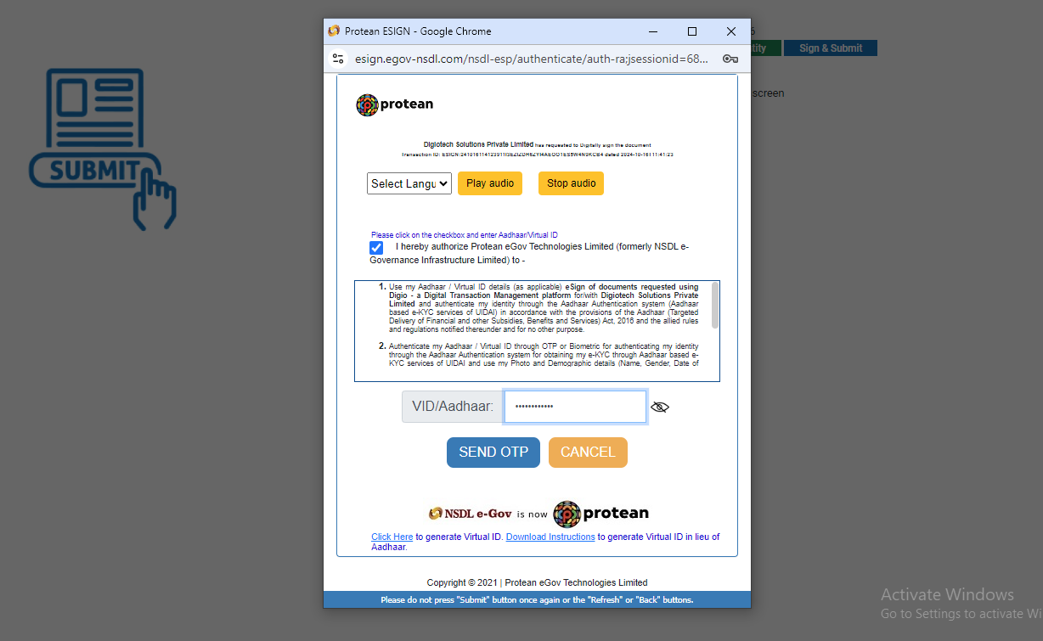
Accept Terms & Conditions, Enter your Aadhar no. and click on send OTP
Sign KYC application :

Slide 31
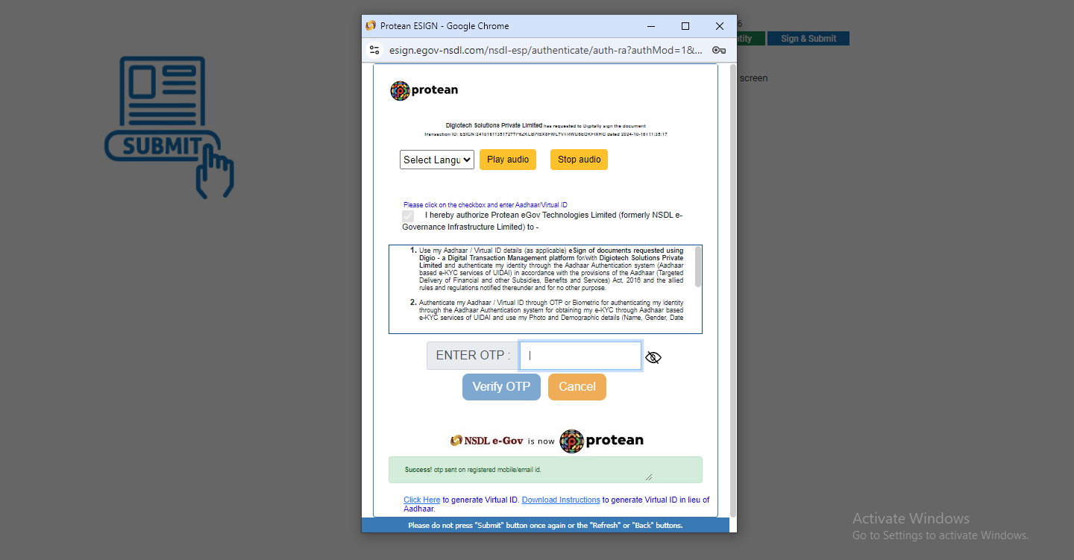
Enter OTP & click on Verify OTP
Sign KYC application OTP :

Slide 32
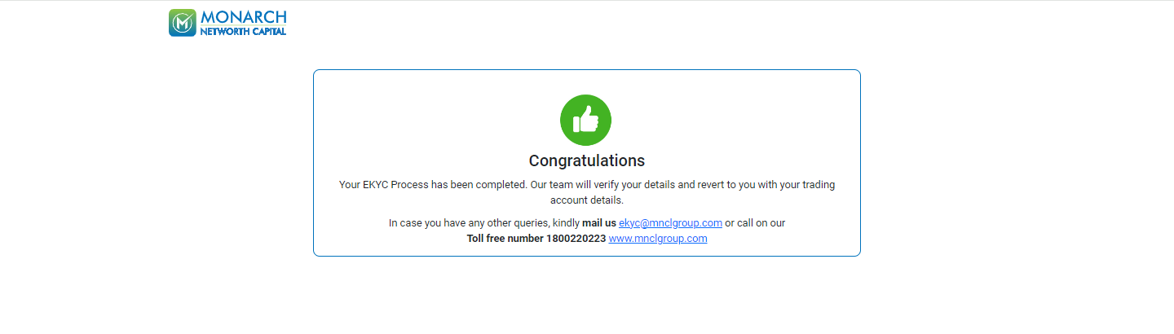
Account opening process completed.
EKYC journey completed:

Slide 33

THANK
YOU

